Slide 1

High cloud Airline Case Study
End-to-End Analytics Pipeline: SQL Extraction, Excel Dashboards, Power BI Insights & Tableau Visualizations

Slide 2













Table of Contents
Introduction
Key Performance Indicators (KPIs)
SQL Queries and Results
Excel Dashboard
Power BI Analysis
Tableau Visualization
Challenges Faced
Conclusion
Thank You

Slide 3

01. Introduction
Project Background
Core Objectives
High Cloud Airlines is a fictional airline company operating flights across multiple countries, states, and cities.
The company generates large volumes of flight, passenger, and operational data every day.
Manual analysis of this data is time-consuming and inefficient.
Management requires an interactive dashboard to monitor airline performance and operational efficiency.
The project uses Tableau to transform raw flight data into meaningful visualizations.
The dashboard provides real-time insights through interactive charts, maps, and filters.
It helps analyze key business metrics such as Load Factor, Number of Flights, Top Airlines, and Popular Routes.
Users can search flights using Source and Destination filters (Country → State → City).
The dashboard supports data-driven decision-making for route planning, capacity utilization, and performance monitoring.
The solution enables management to identify trends, improve operational efficiency, and enhance business performance.
Develop an interactive Tableau dashboard to analyze airline performance.
Monitor key performance indicators (KPIs) such as Load Factor, Number of Flights, and Carrier Performance.
Visualize flight trends across Yearly, Quarterly, and Monthly periods.
Identify the Top 10 Airlines and Top Flight Routes based on operational data.
Compare Weekend vs. Weekday flight occupancy to understand passenger travel patterns.
Enable users to search flights using Source and Destination filters (Country → State → City).
Provide geographical insights through interactive maps and location-based visualizations.
Transform raw flight data into meaningful, easy-to-understand business insights.
Support data-driven decision-making for route planning, capacity utilization, and operational efficiency.
Improve reporting by replacing manual analysis with an interactive and dynamic dashboard.

Slide 4

02. Key Performance Indicators (KPIs)
18M+
Core Metrics Breakdown
✈️
Load Factor Analysis: Yearly, Quarterly, and Monthly seat occupancy trends.
Total Passengers
.
🛫
Carrier Performance: Compare airlines based on operational efficiency.
🌍
Route Analysis: Identify high-demand routes based on total flights.
200+
📅 Weekend vs Weekday Analyse: passenger travel behaviour.
Total Airlines
🔍 Interactive Flight Search: Search flights using Country →State → City filters.
100+
🏆 Top Airlines & Routes: Identifies the best-performing airlines and busiest flight routes.
Total Country

Slide 5
03. SQL Queries and Results
Relational Data Extraction
🗄️ Data Retrieval:
Extracted airline operational data from a relational SQL database using optimized SELECT queries.
📊 Aggregation & Analysis:
Applied GROUP BY, ORDER BY, and aggregate functions (COUNT, SUM, AVG) to generate KPI-ready datasets.
🔗 Filtering & Data Preparation:
Used WHERE clauses and calculated fields to filter records and prepare data for Tableau visualizations.

Slide 6
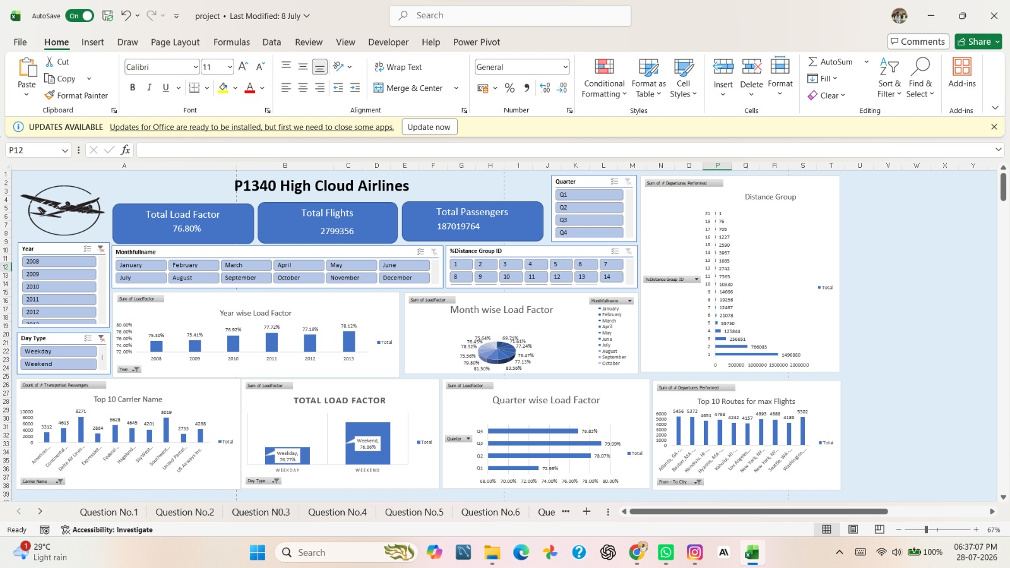
04. Excel Dashboard Analysis
Business Benefits
Monitor airline performance in one dashboard.
Identify peak travel seasons.
Optimize flight scheduling.
Improve route planning.
Compare carrier performance.
Support data-driven decision-making.
Enhance operational efficiency and profitability.

Slide 7
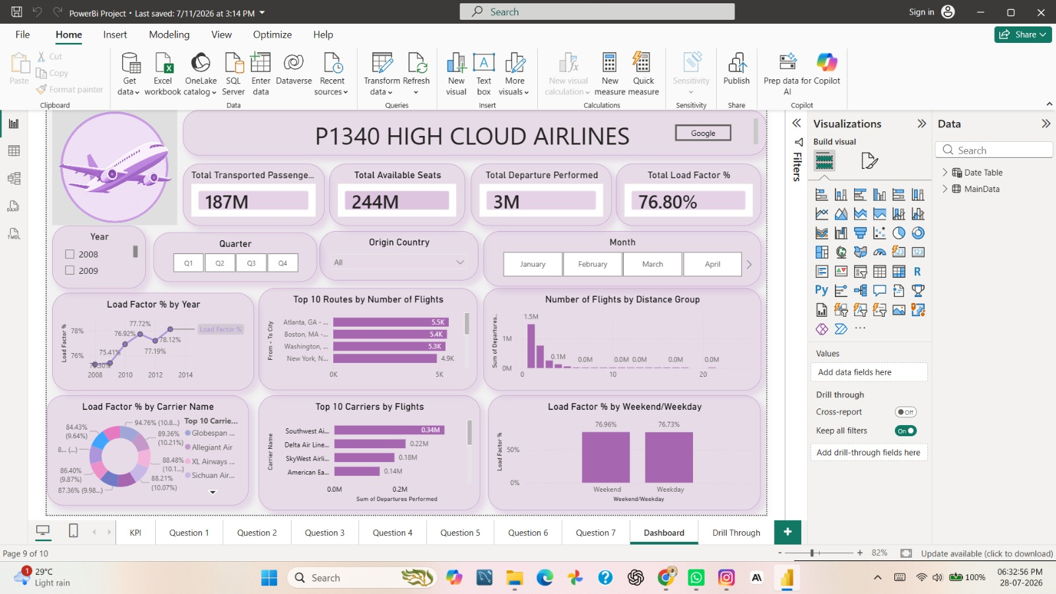
05. Power BI Analysis
Dashboard Overview
This Power BI dashboard analyzes the performance of P1340 High Cloud Airlines, providing insights into passenger traffic, flights, seat utilization, and operational efficiency.
Key Performance Indicators (KPIs)
The dashboard highlights four main KPIs:
187M Total Transported Passengers
244M Total Available Seats
3M Total Departures Performed
76.80% Overall Load Factor
Interactive Filters
Users can filter the data by Year, Quarter, Origin Country, and Month, enabling dynamic analysis of airline performance across different time periods and locations.
Performance Analysis
Visualizations show Load Factor by Year, Top 10 Routes, Top 10 Carriers, Flights by Distance Group, and Weekend vs Weekday Load Factor, helping identify trends and busiest operations.

Slide 8
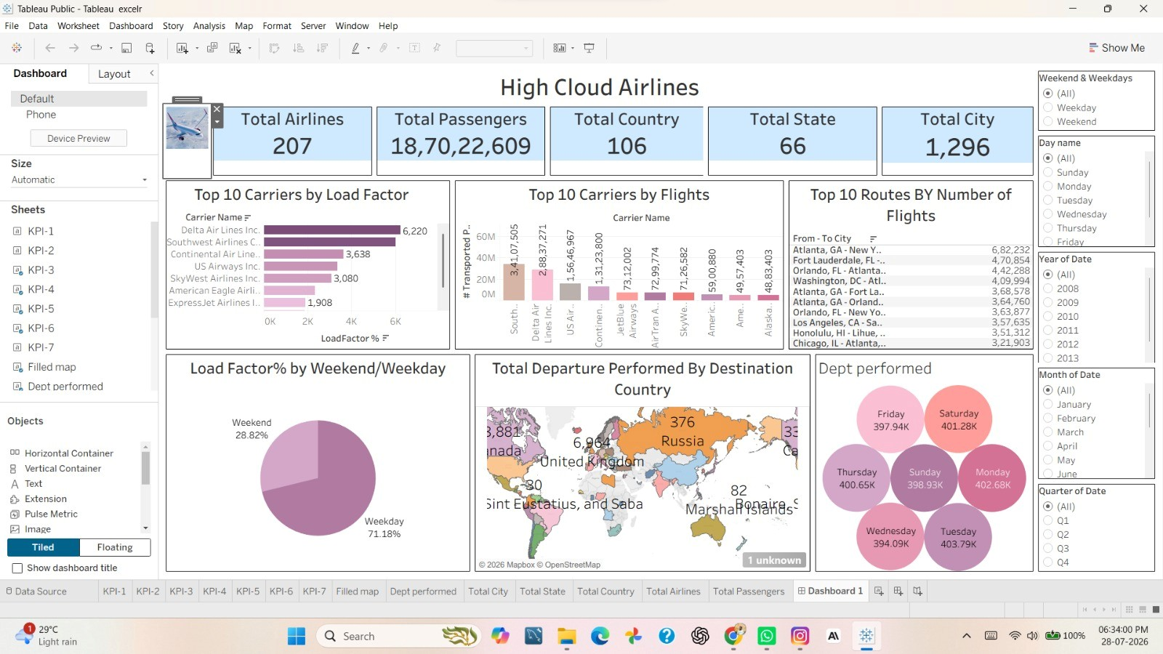
06. Tableau Visualization
1. Dashboard Overview
This Tableau dashboard provides a comprehensive analysis of High Cloud Airlines, focusing on airline performance, passenger traffic, routes, destinations, and operational efficiency.
2. Key Performance Indicators (KPIs)
The dashboard displays important metrics:
207 Total Airlines
187 Million Total Passengers
106 Countries
66 States
1,296 Cities
3. Interactive Filters
Users can analyze the data using filters such as Weekend/Weekday, Day Name, Year, Month, and Quarter, making the dashboard dynamic and easy to explore.
4. Performance Analysis
The dashboard highlights Top 10 Carriers by Load Factor, Top 10 Carriers by Flights, Top 10 Routes by Number of Flights, Load Factor by Weekend vs Weekday, and Departures by Day, helping identify operational trends.

Slide 9




07. Challenges Faced
Data Quality & Inconsistency
🗄️ SQL Query Optimization
📊 Dashboard Design & Performance
Challenge: Dataset contained missing values and inconsistent date fields (Year, Month, Day stored separately).Special characters in column names (e.g., # Available Seats, Month (#)) made SQL queries more complex.
Solution: Cleaned the data using SQL. Created a proper Date field and standardized data types before importing into Tableau.
Challenge: Extracting KPI-ready data required aggregating large datasets. Calculating Load Factor, Top Routes, and Carrier Performance involved multiple aggregate functions and grouping.
Solution: Used SELECT, WHERE, GROUP BY, ORDER BY, COUNT(), SUM(), and ROUND() to prepare summarized datasets for Tableau.
Challenge: Displaying multiple KPIs on one dashboard while maintaining clarity and responsiveness. Implementing interactive filters without affecting dashboard usability.
Solution: Designed separate KPI worksheets and combined them into a single dashboard. Optimized filters and visualizations to improve dashboard performance and user experience.

Slide 10
08. Conclusion & Actionable Recommendations
✈️ Improve Load Factor Recommendation: Monitor low load factor periods and optimize flight schedules or promotional campaigns to improve seat occupancy and maximize revenue.
🛫 Optimize High-Demand Routes Recommendation: Increase flight frequency or aircraft capacity on the busiest routes while reviewing low-demand routes for schedule optimization.
📊 Enhance Performance Monitoring
Recommendation: Use the interactive Tableau dashboard to continuously monitor KPIs such as Load Factor, Carrier Performance, and Flight Trends for faster business decisions.
🗄️ Automate Data Pipeline
Recommendation: Integrate the SQL database directly with Tableau through scheduled refreshes to provide near real-time reporting and reduce manual data preparation.

Slide 11
09. Thank You
Questions & Answers Discussion

